Slide 1
Implement Graph-specific PyTorch Dataloader using DALI and cuGraph
20230531
박현우

Slide 2
Table of Contents
NVIDIA Data Loading Library (DALI)
cuGraph
Proposal: adopt cuGraph into DALI

Slide 3
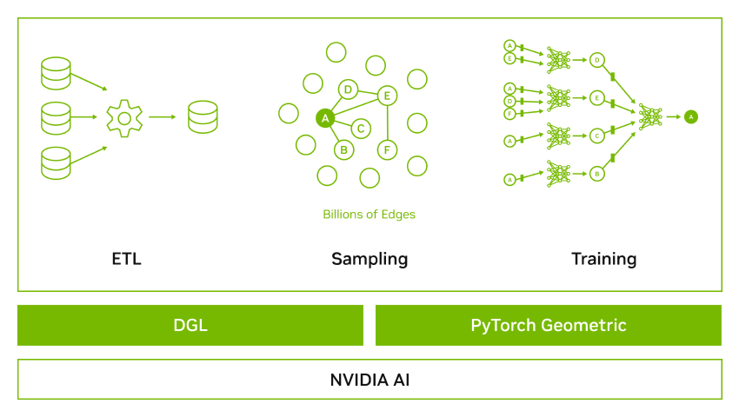
NVIDIA Data Loading Library (DALI)
NVIDIA Data Loading Library is a component of NVIDIA Graph Neural Network Frameworks.

Slide 4
NVIDIA Data Loading Library (DALI)
Most of preprocessing tasks typically used to run on the CPU, due to simplicity, flexibility, and availability of libraries.
Meanwhile, recent advances in GPU architectures have significantly increased GPU throughput.
Hereby, Dense multi-GPU systems train a model much faster than data can be provided by the input pipeline, leaving the GPUs starved for data.

Slide 5
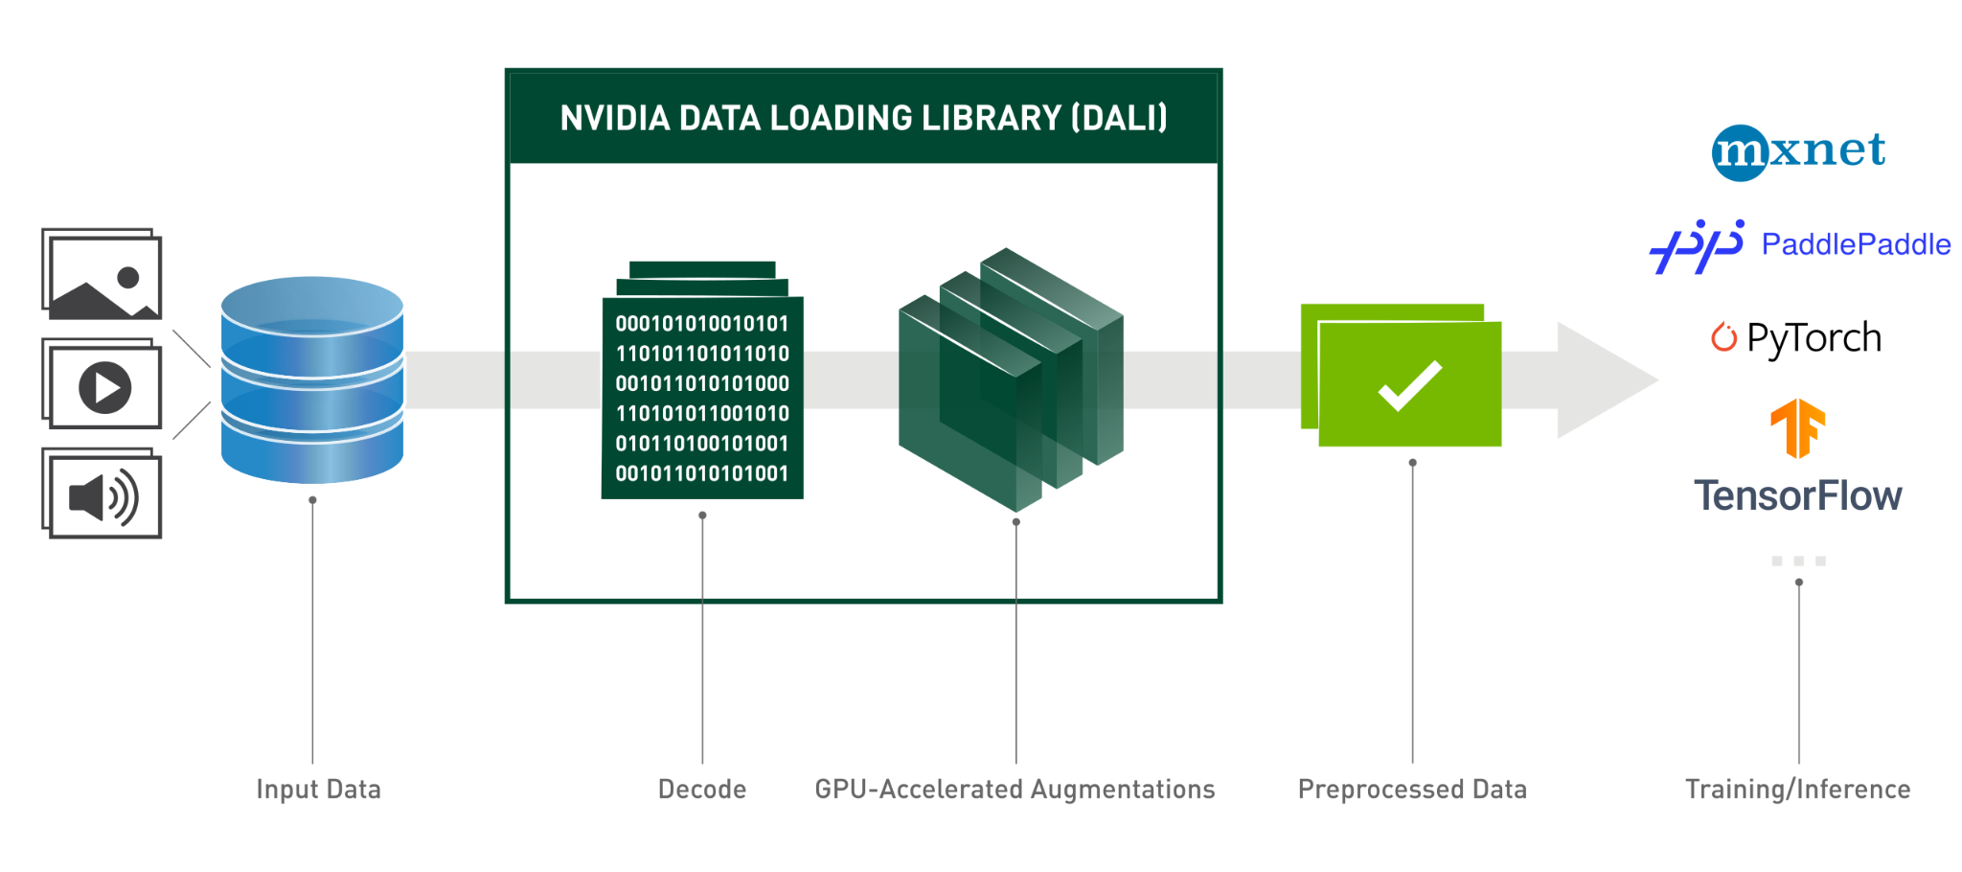
NVIDIA Data Loading Library (DALI)
NVIDIA Data Loading Library (DALI) is a result of our efforts to find a scalable and portable solution to the data pipeline issues;
i.e. shifting centroid of preprocessing from CPU to GPU.

Slide 6
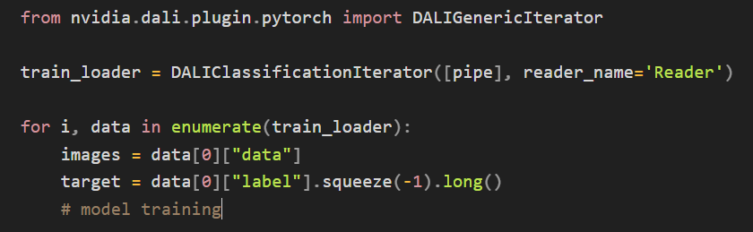
1.1 DALI Concepts
An important feature of DALI is plugins, which can be used as drop-in replacements for frameworks’ native datasets;
by
Defining DALI pipeline once
wrapping it with data iterator wrapper of any supported frameworks.

Slide 7
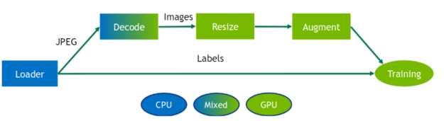
1.1 DALI Concepts
The main entity in DALI is the data processing pipeline:
A pipeline is defined by a symbolic graph of data nodes connected by operators and run in an asynchronous fashion.

Slide 8
1.1 DALI Concepts
DALI can offload processing to the GPU by utilizing special operators with a Mixed backend,
that receives
inputs placed on CPU memory
and output data placed in GPU memory.

Slide 9
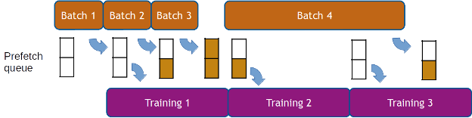
1.2 DALI optimization features
As DALI’s execution is asynchronous, DALI allows for data prefetching,
that is, preparing batches of data ahead of time before they are requested so that the framework has always data ready for the next iteration.
DALI handles data prefetching transparently for the user, with a configurable prefetch queue.

Slide 10
1.2 DALI optimization features
Other performance optimization strategies are supported:
Operator Buffer Presizing
Prefetching Queue Depth
File/Data Readers fine-tuning
@@@ Read on Notion
https://docs.nvidia.com/deeplearning/dali/user-guide/docs/advanced_topics_performance_tuning.html#

Slide 11
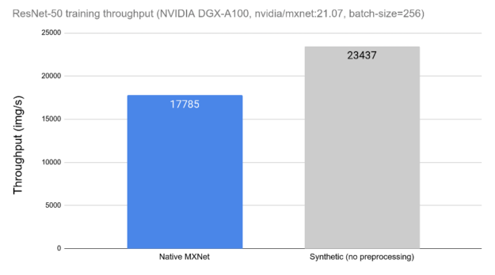
1.3 DALI Performance
(Right side)
performance of the same network
without the impact of data loading and preprocessing,
by replacing it with synthetic data.
= can be used as a theoretical upper limit.

Slide 12
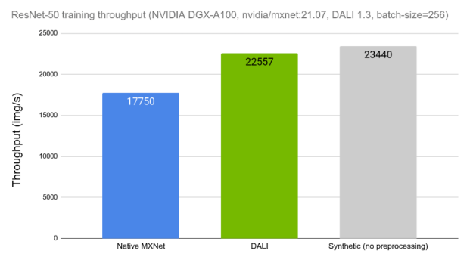
1.3 DALI Performance
We can see
how the training throughput with DALI is much closer to the theoretical upper limit (synthetic example).

Slide 13
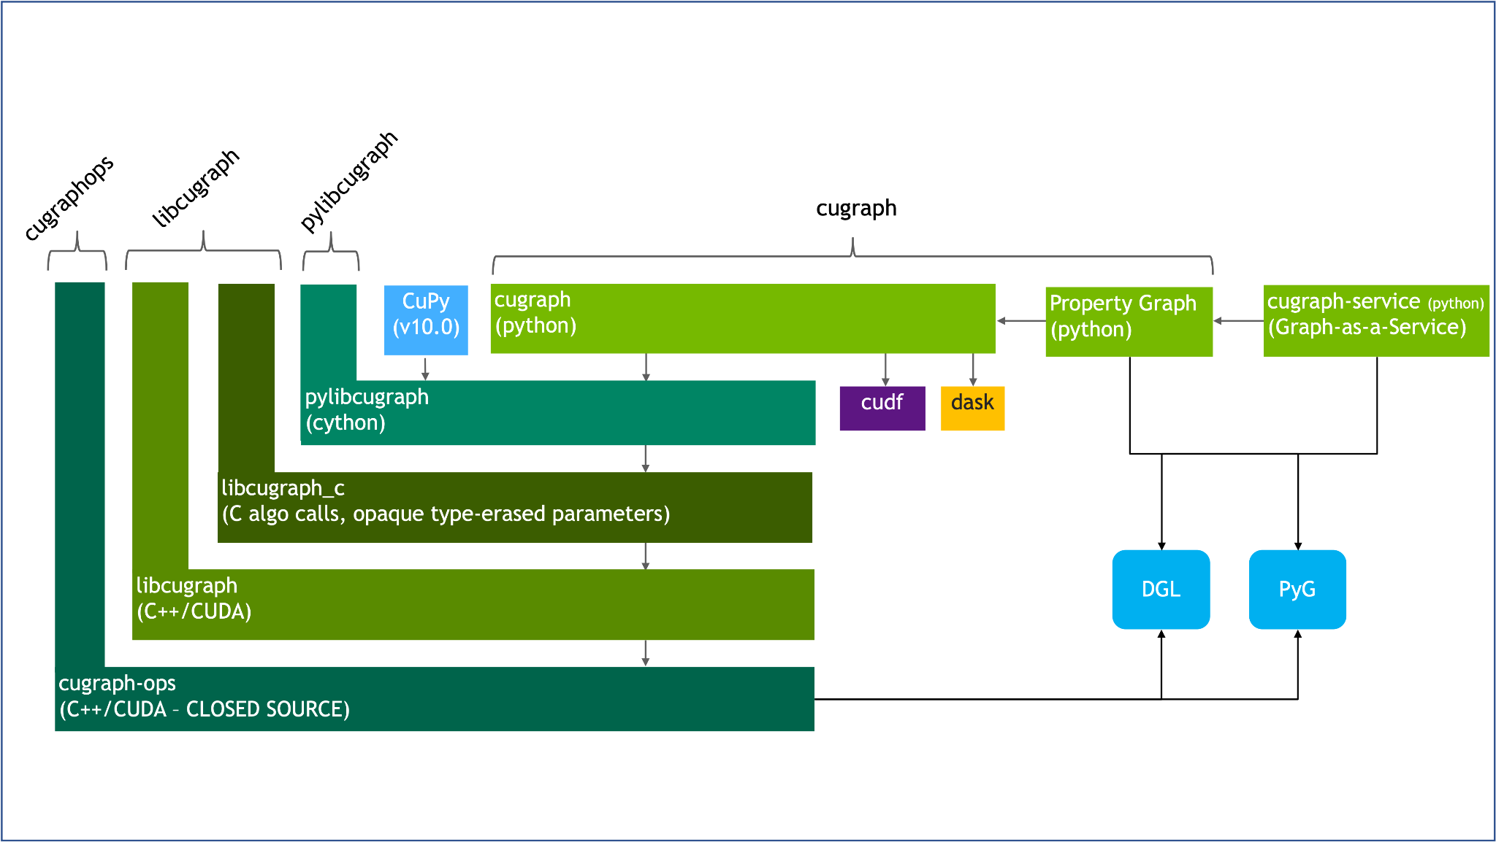
2. cuGraph
RAPIDS cuGraph is a collection of GPU-accelerated graph creation/manipulation and algorithms.

Slide 14
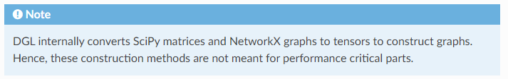
2.1. Problem of other graph libraries
Currently, by default, DGL (and PyTorch Geometric) depend for graph creation and manipulation on NetworkX and simple PyTorch tensor.
The problem is that NetworkX is merely pure python hashable object;
i.e. not supported by CUDA, thus involving conversion overhead.

Slide 15
2.1. Problem of other graph libraries
Although DGL also implements Graph types using PyTorch tensor, such approach is not fully optimized by CUDA;
for example, no CUDA optimization for CSR (Compressed Sparse Row).
Also, DGL itself lacks of CUDA optimized algorithms;
e.g. Multi-GPU pagerank algorithm or renumbering algorithms

Slide 16
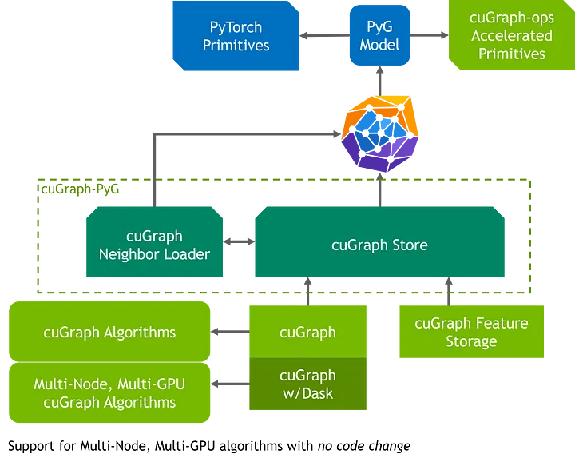
2.2. Concepts of cuGraph
cuGraph is fully supported by CUDA and provides NetworkX-like API, enabling drop-in replacement for NetworkX-using frameworks (i.e. DGL and PyG).

Slide 17
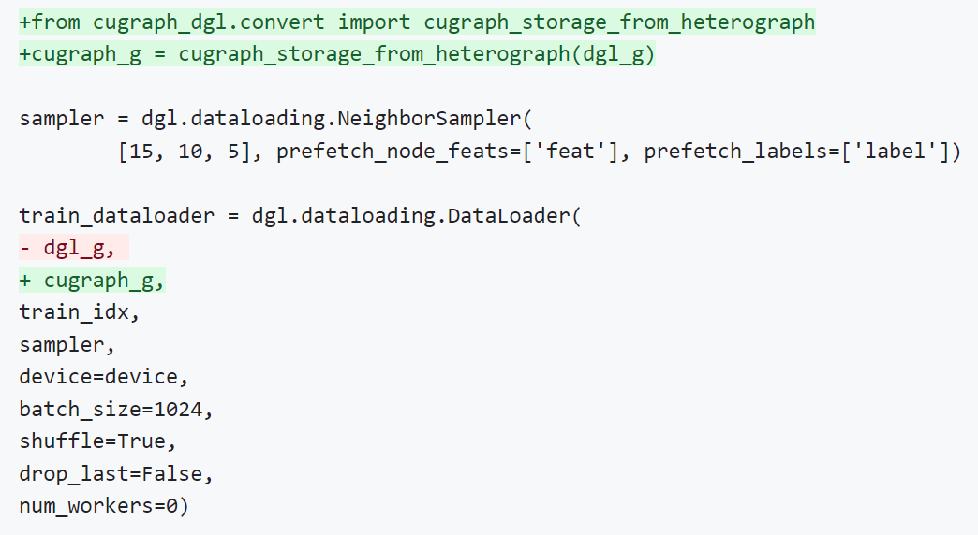
2.2. Concepts of cuGraph
Example of DGL adoption of cugraph:

Slide 18
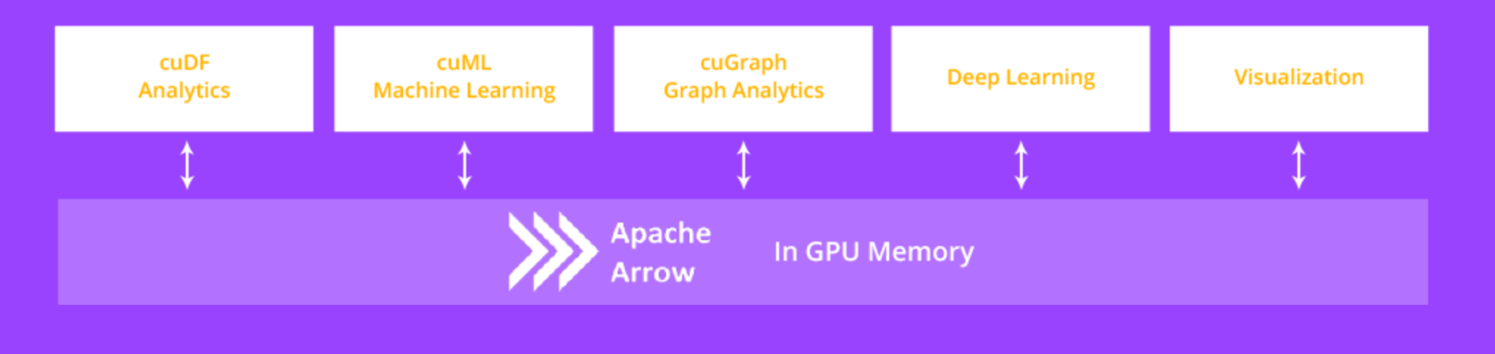
2.2. Concepts of cuGraph
Specifically, cuGraph operates on GPU DataFrames or cuDF, thereby allowing for seamless passing of data.
RAPIDS cuDF is GPU version of Apache Arrow and thus eliminates serialization overhead by leveraging Arrow memory format.

Slide 19
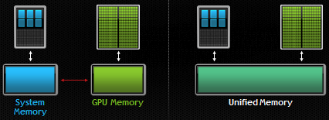
2.3. CUDA Unified memory and Oversubscription of cuGraph
Unified memory is a single memory address space accessible from any processor in a system. i.e. Host memory + Device memory
The data movement is done automatically. (by RAPIDS Memory Manager (RMM))

Slide 20
2.3. CUDA Unified memory and Oversubscription of cuGraph
Oversubscription is simply
the ability to allocate GPU memory larger than what is physically available on the device,
and have the GPU automatically page in data as needed.
Pascal and later GPU architectures include hardware to accelerate unified memory data movement (paging);
i.e. Paging Migration Engine

Slide 21
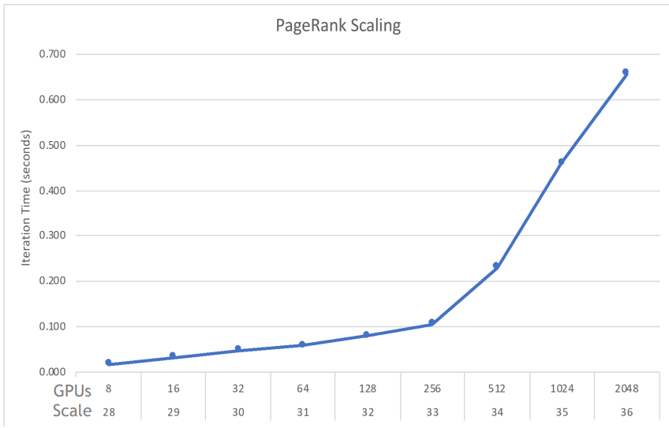
2.4. cuGraph Performance
cuGraph scales smoothly from small graphs on 1 GPU to massive graphs with trillions of edges on 2,048 GPUs. (Tested on Selene cluster)
Benchmark of PageRank on Scale 36 dataset (1.1 trillion directed edges):
19.3 seconds (0.66 seconds per iteration, 2,048 GPUs)

Slide 22
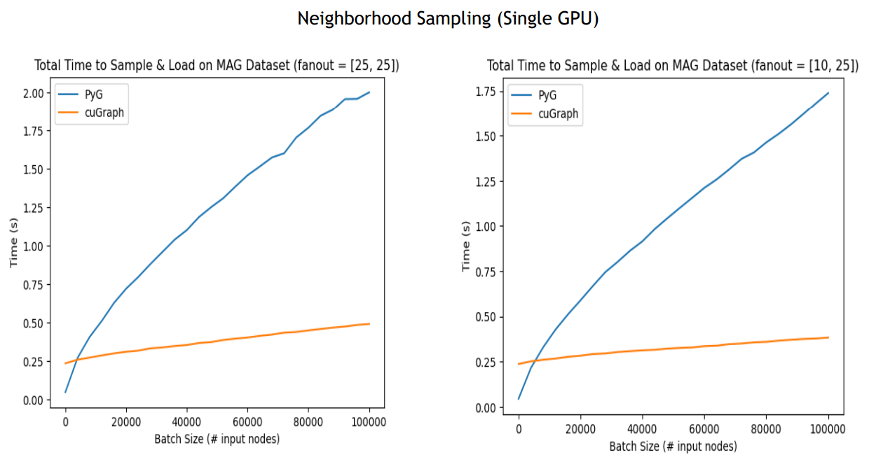
2.4. cuGraph Performance
In Single-GPU environment, cuGraph outperforms PyG (NetworkX + PyTorch tensor) on Neighboring sampling algorithms:

Slide 23
3. Proposal: adopt cuGraph into DALI
To sum up,
DALI
Plugin nature helps simple integration with many DL frameworks
Provide rich pre-built preprocessing operators and optimization strategies.
cuGraph
Fully supported by CUDA
Provide scalability and CUDA-optimized algorithms
Utilize CUDA Unified memory and Oversubscription

Slide 24
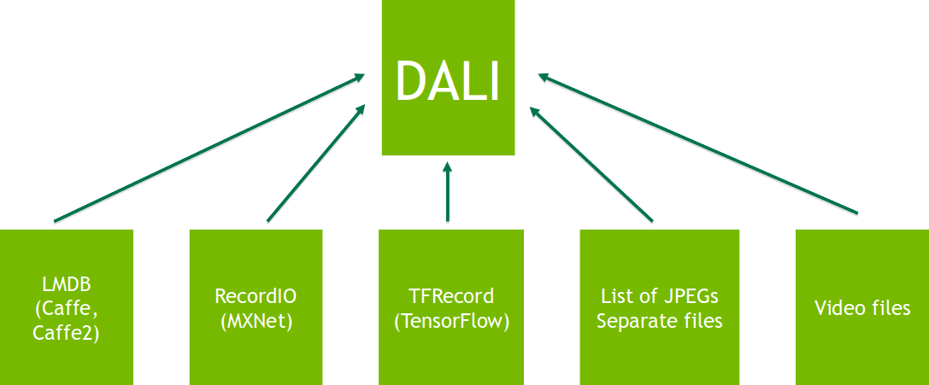
3. Proposal: adopt cuGraph into DALI
Currently, DALI supports following storage formats or ExternalSource operator:
LMDB,
RecordIO (in MXNet),
TFRecord (in TensorFlow)

